Slide 1



Murder Board - Technology

Slide 2
Agenda : Project Architecture information
Tech Stack used
Architecture (System, Data & Integration)
Build & Deployment (Config management and release pipeline)
Non Functional Requirements
Documentation

Slide 3




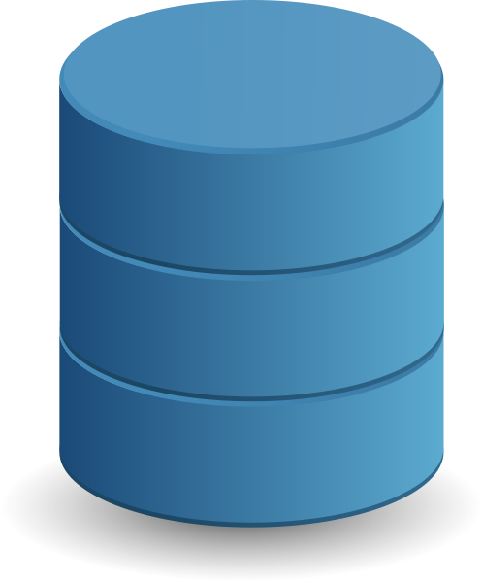



Tech Stack
Front end
1
2
Back End
Angular
React JS
Spring Boot
Django
Database
4
3
Build and deploy
Oracle / POstgres.
Terraform, Github Actions
AWS Code Pipeline
This Photo by Unknown Author is licensed under CC BY-NC

Slide 4
System Architecture
Architectue Diagaram

Slide 5
Technology Architecture
Technical Architectue Diagram detailing network level segregation

Slide 6
Database Design/Architecture
Data storage solutions
Databases

Slide 7
Data Model
Data model and access pattern

Slide 8
Performance Metrics
Database query response
Caching, Read/Write replicas

Slide 9
Data Security (Rest + Transition)
Data Encryption
PII/PHI data security

Slide 10
API Integration + Third Party Integration
Api layer details (REST, SOAP etc.)
Third party integration

Slide 11
Data Integration
Data sharing
Streaming data flow
Batch Data flow
User input

Slide 12
Performance Metrics
Core API performance
Aggregation Layer performance

Slide 13
API Security (Authentication + Authorization)
API Authentication & Autherization

Slide 14
Development Tools & Setup
Development Environment IDE, Data
SCM tools
Servers
Unit testing
Code reviews (Autmated and manual)

Slide 15
Version management and branching strategy
Milestone
10 Aug
Milestone
5 Dec
2022
Jan | Feb | Mar | Apr | May | Jun | Jul | Aug | Sep | Oct | Nov | Dec
Trunk
Release 1
Branch 2
Branch 3
Release 2
Branch 3
Branch 4
Code in Production
merge
merge
100%
Feb 25 – July 17
merge
95%
Copy
Apr 5 - Jul 17
Aug 12 - Nov 27
Merge
20%
merge
Jul 12 - Aug 19
Copy
5%
Sep 20 - Nov 27
Release 1
Release 2
%
Completion
Notes:
© Copyright PresentationGO.com – The free PowerPoint template library

Slide 16
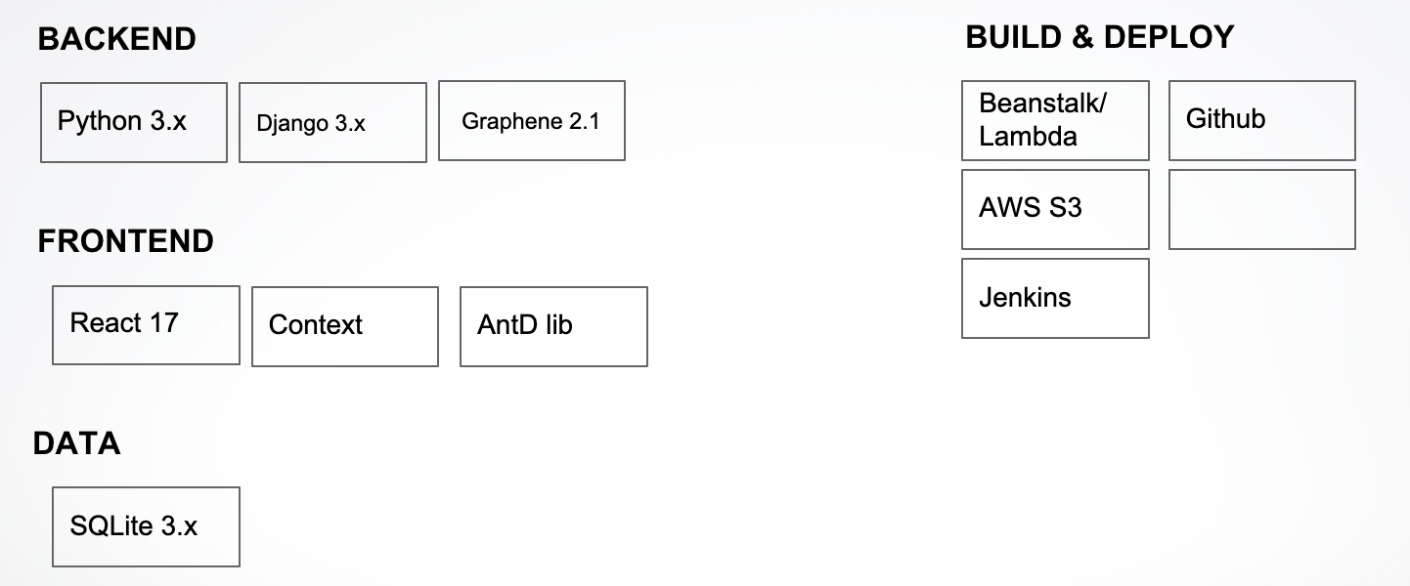
CI / CD process
Text Here
Text Here
This slide is 100% editable. Adapt it to your needs and capture your audience's attention.
This slide is 100% editable. Adapt it to your needs and capture your audience's attention.
Text Here
Text Here
This slide is 100% editable. Adapt it to your needs and capture your audience's attention.
This slide is 100% editable. Adapt it to your needs and capture your audience's attention.
Project Proposal Waste Management
Text Here
Text Here
This slide is 100% editable. Adapt it to your needs and capture your audience's attention.
This slide is 100% editable. Adapt it to your needs and capture your audience's attention.
Text Here
This slide is 100% editable. Adapt it to your needs and capture your audience's attention.

Slide 17
Authentication and Authorization

Slide 18
Security
- Secret Management: Secret Manager
- Tools used for Security testing
- Infra security: https
- Web application security: OWASP attacks testing
- API security: Bearer token or any other auth tokens
- Disaster recovery: CICD using Git-hub Actions
- PII/confidential data storage:Secret Manager
- Secret Management: How we are storing passwords or secrets, AWS credetials,
- Tools used for Security testing
- Infra security: Firewall, allowed ports, https, high availability
- Web application security: OWASP attacks testing
- API security: Authentication used, session management
- Disaster recovery: backup and recovery plan
- PII/confidential data storage: How we are storing, who can view and how we are managing

Slide 19
Performance
API response time, UI load time, Tools used to measure this

Slide 20
Availability, Scalability & Disaster Recovery
API response time, UI load time, Tools used to measure this

Slide 21
Logging & Monitoring

Slide 22
Error and Exception Handling
Exception and Error handling
Retry & restart-ability

Slide 23
Documentation
Onboarding
Project setup
API
Database attributes
Code comments and Technical details

Slide 24
API and 3rd party services used
1. Technologies used - FE, BE, Database, Build and Deploy
2. Architecture diagram
3. Logical/HLD diagram
4. CI/CD setup
5. DB Design
6. API Specification
7. Testing
- Unit testing % coverage
- Integration Testing
- Automation testing
- Security Testing
- Performance Testing
8. Review checklist
- Coding guidelines: Project coding guidelines
- Log Management: How we are storing it, tool to manage, exception alerts
- Monitoring: Notifications, server usage, API performance, Health check, Application monitoring
- Documentation : API, project setup, Code comments, Tech Documentation
- Error Handling: Enough logs to debug any issue, custom exception handling, retries & restart of processes,
- Performance: API response time, UI load time, Tools used to measure this
- 3rd Party Integrations: Any integrations that we are doing, retries & timeouts, exception handling
- Single point of failure: Find out single point of failures in application
9. Security:
- Secret Management: How we are storing passwords or secrets, AWS credetials,
- Tools used for Security testing
- Infra security: Firewall, allowed ports, https, high availability
- Web application security: OWASP attacks testing
- API security: Authentication used, session management
- Disaster recovery: backup and recovery plan
- PII/confidential data storage: How we are storing, who can view and how we are managing
- Some more need to be added.
10. NFRs
11. Known Issues

